Slide 1

Lariat Fleet Rentals
Objectives & Strategies for how to improve in 2019
Capstone 1 Review by Joseph Bermudez

Slide 2
2018 Lariat Fleet Rentals Earnings
 | 2018 Financial Baseline
Total Revenue | $52,830,207.00
Total Cost | $33,076,688.64
Total Profit | $19,753,518.36

Slide 3
Objectives & Strategies
Objective: Increase overall revenue for Q1 2019
Strategy 1: Cars from 2018 Q4 that yield a negative profit should be foreclosed upon
Strategy 2: Introduce a fee for Airport Transactions/Rentals

Slide 4
Strategy 1
Top 10 least profitable models300
Austin Mini Cooper S | $ (4,781.96)
BMW 745 | $ (3,510.76)
Buick Somerset | $ (4,450.40)
Daewoo Nubira | $ (5,843.92)
Dodge D150 Club | $ (4,046.28)
Mazda B2500 | $ (3,475.16)
Mercedes-Benz 300E | $ (3,876.40)
Mercedes-Benz GLK-Class | $ (6,076.88)
Oldsmobile 98 | $ (4,840.48)
Saturn Aura | $ (4,210.00)
Downsize non-profitable vehicles
Cutting Costs = Higher $ Margin

Slide 5
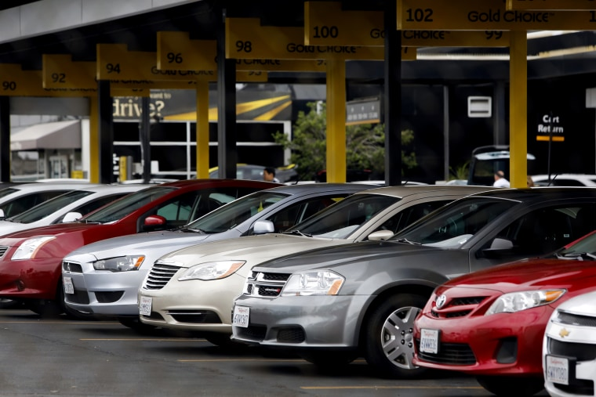
Strategy 2
Luxury & Convenience
Airport Fee = Immediate cashflow !
Introducing a $30 convenience fee will yield over 1 million!
No Cuts needed!
 |  | Dynamic Airport Fee | $30
 | 2018 Baseline | Strategy 1 | Strategy 2
Number of Branches | 50 | 50 | 50
Number of Cars | 4000 | 3345 | 4000
Total Cost | $ 33,076,688.64 | $ 27,307,097.04 | $ 33,076,688.64
Total Revenue | $ 52,830,207.00 | $ 48,212,749.00 | $ 53,900,937.00
Total Profit | $ 19,753,518.36 | $ 20,905,651.96 | $ 20,824,248.36
Increase in Profit | - | $ 1,152,133.60 | $ 1,070,730.00

Slide 6
2018 Lariat Fleet Rentals Earnings (in millions*

Slide 7
Which is right for Lariat?
Strategy 1 has the most risk/reward factor
Strategy 2 is a more measured response; easier scalability
Strategy 2 is the most cost-effective and lucrative in terms of profitability, also the easiest to implement.
The dynamic airport fee is the recommended strategy entering into 2019 Q1.

Slide 8
Thank you
Any Questions?

